Slide 1
Academic Research
Ahmed Al-Jumaily, PhD, MSc., BSc
Professor of Biomechanical Engineering
Institute of Biomedical Technologies
Auckland University of Technology,
Auckland, New Zealand
ENGE817
Thursday 8am, WA220

Slide 2
Outlines
Types of Research
Industrial Research
Triangle of Survival
Collaboration with Industry
Conducting Research
Research Proposal-Inverted Cone Approach
Thesis/dissertation structure
Good Thesis

Slide 3
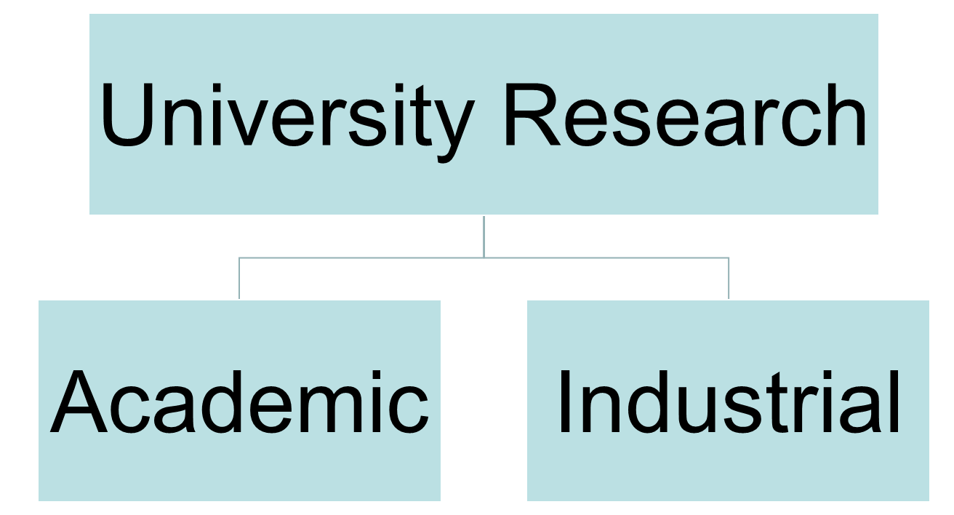
Which is better?

Slide 4
INDUSTRIAL RESEARCH
Operational Differences
Corporations
Academia
For-profit
Goal: Solve Unmet Needs
Time-to-market
Focused on Prescribed Task(s)
Operation Engines
  Engineering/Design
  Product Dev
  Manufacturing
  Quality
  Legal/Regulatory
  Sales/Marketing
Non-profit
Basic Research Driven
Government Funding Focus
Domain Experts
Institutes/Centers
Tenure – Freedom
Less Structured Environment
Idea Factory - “What if?”
Notes:
TWO DIFFERENT CULTURES

Slide 5
Motivational Differences
Company
Academia
Expectations
  Accomplish your task(s)
  Team player
  Process driven
  Project Focus
Reward System
  Product Success
  Secure IP
  Profit
Expectations
  Publish
  Bring in funding
  Educate Students
  Outreach
Reward System
  Recognized as the Expert
  Graduate Top Students
  Create New knowledge
Notes:
TWO DIFFERENT CULTURES

Slide 6
How to Obtain Collaborations
Resolve IP and Confidentiality Issues Up Front
Get University and Corporation on the Same Side of the Table
Host Events at Both Sites
Recognize that Students are the Connectors
Work on Real Design Problems
Recruit Alumni into Key Interface Positions
Reward Faculty and Employees who Fill Leadership Roles

Slide 7
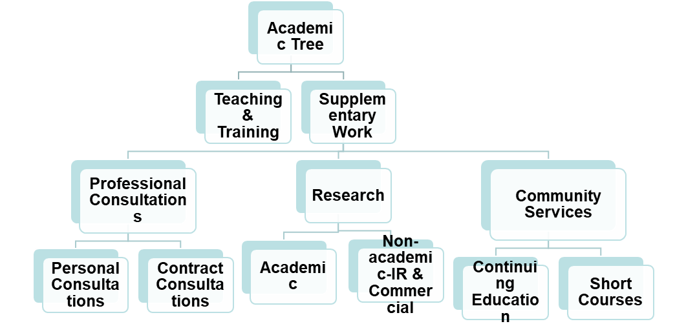
Profession Educators
Not School Teachers
Companies serve university by
- Having the students to conduct
research on their premises
- Having students to apply
theories to the practical world
and to gain knowledge of new
Technologies
University serves companies by:
- Solving their problems
- Developing new ideas for them
- Updating their knowledge on
the State of the Art Technologies
University
Industry
Triangle of
survival
Advantages of IR
Links with Industry
Better Opportunities for Students
Generate New Research topics
Generate Funds
Narrowing the Gap
It’s a Service to the COMMUNITY
IR essential for academics
Continuous Contact
Updating Knowledge
Refreshing Bank of Knowledge
Knowing New Problems
Generating New Ideas and Subjects to Teaching
It’s a CHALLENGE
Student
Student’s gains:
- Practical knowledge,
training, he/she is ready
- Possibility of Employment

Slide 8
Essential
TRUST COINFEDENCE DELIVERY
Weaknesses & Strengths in University-Industry
Relationships-How can we remove the barriers?
Introduce to them the idea.
Convince them it is workable.
Give them some incentives as to what they can gain
Help them to find financial resources.
Promoting industrial research and consultation
Our Ambassadors- GRADUATES
Personal Contact
Sending adds about what we can do
Inviting Key-Persons from Industry to:
        participate in advisory committees
        present seminars about their companies
        visit our facilities
Knocking Doors; Any Others
Hurdles for the university
Level of achievement by students
Publications
Problems are not up to the academic standards
Lose of IP
Mentoring the student from distance
Cost
Hurdles for companies
IP
Approaches used by university may be too theoretical/hypothetical
Concerns about delivery
Leaks of information
Cost

Slide 9
Collaboration with Universities Works!
Company receives;
  Defined deliverables, including IP
  Rich research/engineering value
  Tangibly organized project
  Try out future employees
University gains;
  Research deployment
  Faculty engagement with industry
  Mission Execution

Slide 10
Industrial Collaborators
Company | Number of Projects | Area of Research
Fisher & Paykel Healthcare Ltd | 42 | Respiratory Devices, System Modelling & Control
Distech Ltd. | 6 | Design, System Modelling and Development
BHP-Steel NZ | 1 | System Modelling and Design
Electronic & Transformer Eng. Ltd | 2 | Design, Control
Fisher & Paykel White ware Ltd | 2 | System Dynamics and Control.
Howick Engineering Ltd. | 1 | Structural Vibration
Jacob International Ltd | 1 | Vibrations
MASTIP Ltd. | 1 | System Modelling &Identifications.
NAVMAN Ltd. | 2 | Measuring Systems
Pacific Lithium (NZ) Ltd | 1 | System Modelling and Control
RNZAF | 2 | Vibrations
Sullivan & Haddon Group Ltd. | 1 | System Modelling
AH Gears | 1 | Design, System Modelling
Pulsecor Ltd | 10 | Noninvasive Arterial Monitoring-Medical Devices
Innovators Ltd | 3 | Design, system dynamics
Ripe Time Ltd | 2 | Sensor Development, Investigation & Design

Slide 11
Research Process Monitoring
Weekly meetings-MUST
Everyday discussion-as necessary
Weekly Writing
  Assess yourself on what you have done
  Easier for you to summarise your work
  Make your focus on what to do next
  Basis for thesis writing

Slide 12
Proposal Writing-PGR9
Look at the general Topic
Break down to components
Look at each component’s literature
Summarise each component and cite literature in chronicle order and relevance to your objectives
Link between components.
Use an Inverted-cone approach.

Slide 13








Inverted-Con Approach
General TOPIC
TOPIC 1
TOPIC 2
TOPIC 4
TOPIC 3
1.
2.
3
1.
2.
3
1.
2.
3
1.
2.
3
Methodology 1
Methodology 2
Methodology 3
Methodology 4
Link all of these to deliver the final objective

Slide 14
Thesis Writing

Slide 15
Type of Thesis
Theoretical
Analytical
Numerical
Experimental
Combination of the above-BEST

Slide 16
Theoretical
Numerically
Experimentally
Simulation
Must validat
Develop a theory from basic principles by applying basic laws

Slide 17
Analytical
Apply available theory/ies to formulate an appropriate model to describe the action of a system, component, process---etc
Validate by comparing with available methods, models, or previous experimental results
Generate experimental or other theoretical /numerical/analytical/simulation results for validation

Slide 18
Numerical
Develop a numerical model to investigate a process/phenomenon
May use available software or build your own
  Remember that available software may not meet your demands
  You must understand how the available software works.

Slide 19
Experimental
To study behaviour/s
To investigate a process or a phenomenon
To validate an available theory or model
To validate your own theory or model
To develop and build a system or components

Slide 20
Thesis Layout
Thesis is assessed by its quality not quantity.

Slide 21
Thesis Length
5-8 CHAPTERS

Slide 22
THESIS LAYOUT
Quality vs Quantity
Abstract
CHAPTER ONE-INTRODUCTION
CHAPTER TWO- Depends on the nature of the thesis
CHAPTER THREE-Validation for theoretical thesis and modelling for experimental thesis
CHAPTER FOUR- Results
CHAPTER FIVE- Discussion, Conclusions, Recommendations and Future Work.
APPENDECIES
REFERENCES

Slide 23
Abstract
Long Abstract is redundant
Maximum one page
Background-1-2 sentences
Objectives-One sentence
Methodology-1-2 sentences
Results-1-2 sentences
Outcomes-1-2 sentences
Conclusion-1 sentence

Slide 24
CHAPTER ONE
INTRODUCTION:
    Background
    Some supportive explanation which should make life easier for the reader to understand what is the intension of your research
    Literature Review (For some thesis this could be a chapter by itself)
    Objectives

Slide 25
CHAPTER TWO
CHAPTER TWO/ Theoretical and Analytical Theses
  Introduction: A few lines explain what the chapter will cover
  Introduce the story about your model or approach (Justify why you are introducing the theory or the model)
  State clearly your assumptions and limitations
  Introduce the basic laws which you are using, then apply them.
  Don’t just list equations, in every step say what you are doing and why

Slide 26
CHAPTER TWO (Cont’d)
Conclude your model or theory with a closure (Summary)
Try to generate some numbers for comparison, or leave to the RESULTS Chapter. A sample will help to tell the reader a lot about your thesis.
Say how you are going to validate.
Closure

Slide 27
CHAPTER THREE
Theoretical-Analytical
Introduction-A few lines about the contents and why this chapter is introduced
If validating using available theoretical/ analytical methods, you must stress why you are using this approach
  Summarise the approach you are using and give all necessary details.
  For brevity, use the appendix for lengthy materials which are done by others
  Closure

Slide 28
CHAPTER THREE
Experimental
Introduction-A few lines about the contents and why this chapter is introduced
Justification for your experimental approach
Give
  Experimental Setup details
  Details of equipment used
  Include some design drawings, photos and schematic diagrams as available
  Methodology/ Procedure
  Comments on the experiments
  Give a sample if not the whole experimental results
  Closure

Slide 29
REVERSE
If the main work is experimental, reverse the previous chapters
If mathematical modeling is not a relevant issue, use statistical modeling
Don’t make your thesis dry using a pure experimental or theoretical approach. Try to support one by the other.

Slide 30
CHAPTER FOUR
RESULTS
Introduction-A few lines about the contents and why this chapter is introduced
Have sections for various results
Don’t put Tables, graphs, pictures without titles
Spread out the tables, graphs and pictures in different section as relevance to the various components of discussion
Try to put results in the same sequence as you have in chapters 2 and 3.

Slide 31
CHAPTER FIVE
Discussion, Conclusions and Recommendations
Introduction-A few lines about the contents and why this chapter is introduced
Keep the discussion in the same sequence as in previous chapters
Use graphs, tables, figures to help you validate, justify, explain---etc
Cite references for comparison if applicable
Have a section at the end that checks if you have met your objectives
Give some conclusions
Give the chance to others to continue on your work by improving, updating, modifying---etc your work

Slide 32
Good Thesis
Avoid Surprises.
It is a story telling-Make the story easy to follow.
Don’t talk about something never mentioned earlier.
Keep reminding the reader of your objectives.
If you give it to dummies, they will be able to understand the concept.

